Slide 1
Assessment Task 3 Feedback
12/4/2017

Slide 2
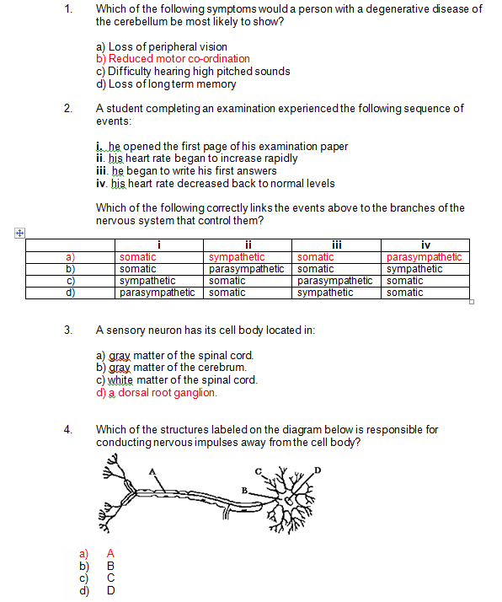

Slide 3
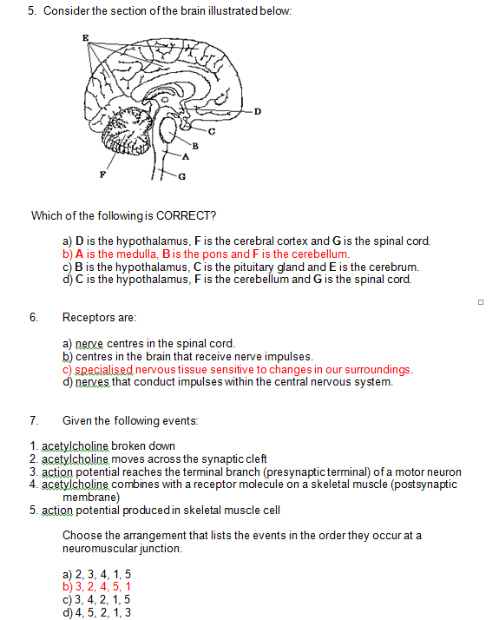

Slide 4
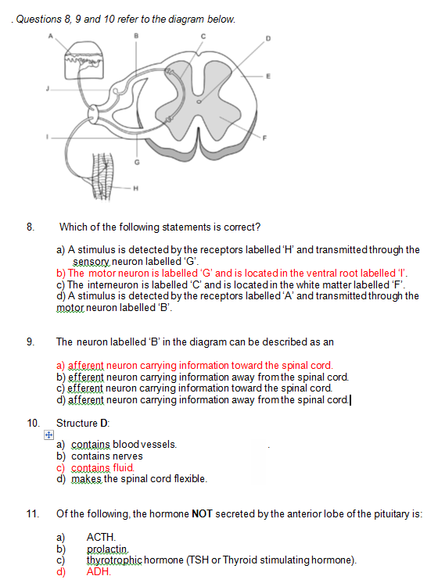

Slide 5


Slide 6
Notes
3: Structure of neurons
5: Sections of the brain
11: Hormones of pituitary
15: Hormone release and action

Slide 7
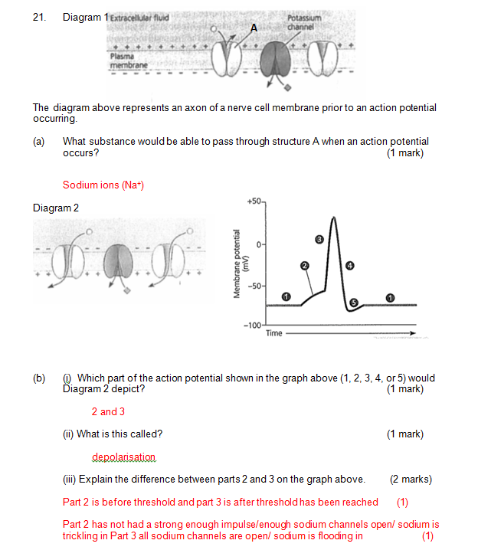

Slide 8
Notes
21a) All okay
bi) Mostly okay (revision)
ii) Read question properly. Most common mistake=action potential.
iii) Not super clear answers. Explain difference=for each part what are they

Slide 9
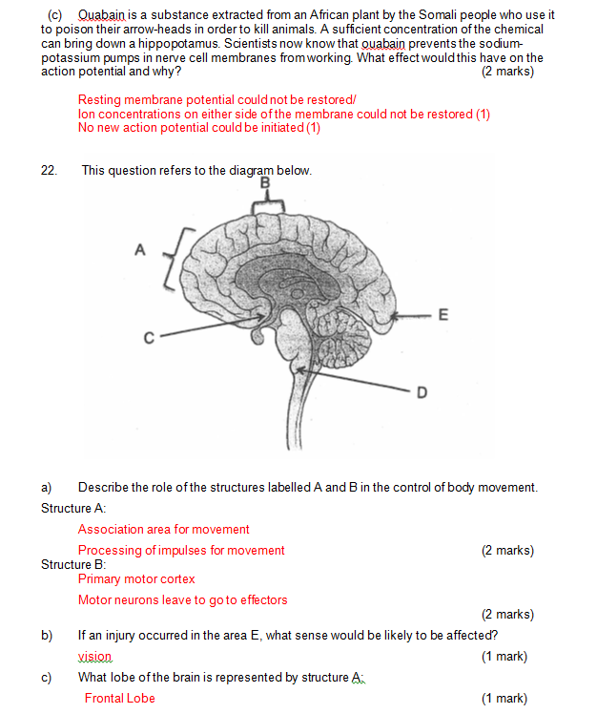

Slide 10
Notes
21 c) Vague explanations. Some got ion concentrations part but did a lot of explaining to get to it.
22a) No-one got this. Very specific section in text book + not super clear. Read question properly/revision
b/c) Some okay with this. Just revision for others

Slide 11
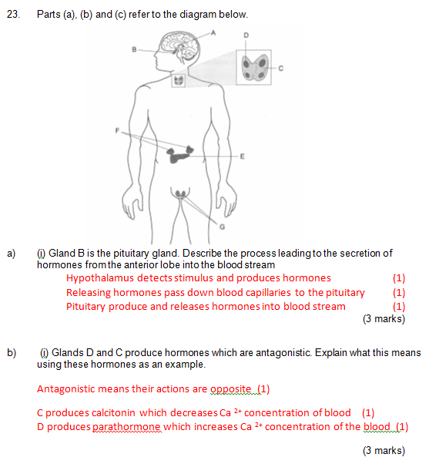

Slide 12
Notes
Most got two marks. Missed hypothalamus receiving stimulus ( a lot of writing otherwise)
Antagonistic definition blurry/vague for most. Hormone examples not a great example in key. Accepted thyroxine but many couldn’t find antagonistic hormone eg. Insulin and glucagon.

Slide 13


Slide 14
Notes
Most okay naming with types
Need revision with examples
Most okay with comparing (4 marks=2 points for each)

Slide 15
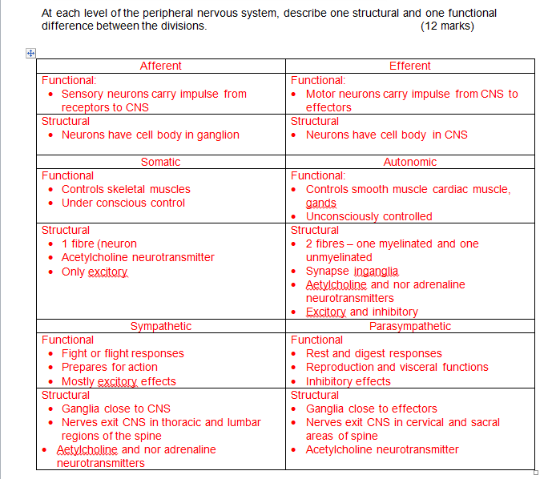

Slide 16
Notes
Most okay with functional
Most struggled with structural
Minimal confusion between two sides.

Slide 17
Overall..
Areas of strengths
Areas to improve
Improved structure of extended answer
Action potential
General knowledge is good
Specific hormone action
Structure of nervous system
Structure of brain specifically location of different sections
Specific points when answering-look to marks.

Slide 18
What’s next…
Identify individual sections you didn’t do well on.
Work out how to improve these
Ask me
Revise content
Revisit how you are learning/revising this information.
How to learn faster: https://www.youtube.com/watch?v=B9SptdjpJBQ
Study Tips based on studies: https://www.youtube.com/watch?v=p60rN9JEapg
Exam Anxiety: https://www.youtube.com/watch?v=FyBdA61GmJ0

